Slide 1

Sanjivani College of Engineering, Kopargaon-423 603
(An Autonomous Institute, Affiliated to Savitribai Phule Pune University, Pune)
Department of Computer Engineering
Subject : DAA
CIA Activity
Problem Statement : Travelling Salesman Problem (Approximate using MST)
1.Walke Akshata (03)
2.Unde Ashwini (04)
3.Attar Rehan (05)
Group Members:-
Guided By- Prof. P. B. Dhanwate

Slide 2

Travelling Salesman Problem (Approximate using MST)
The Travelling Salesman Problem (TSP) is a classic optimization problem that involves finding the shortest possible route that visits a set of cities exactly once and returns to the starting city.

Slide 3

Introduction to the Travelling Salesman Problem (TSP)
The problem is known as NP-hard, meaning there is no efficient algorithm to find the exact solution for large sets of cities.
1
Key Concepts
2
Applications
The goal is to minimize the total distance traveled.
TSP finds practical applications in logistics, transportation, and robotics.
3
Approximation
Approximation algorithms are used to find near-optimal solutions efficiently.

Slide 4

Challenges of the Exact TSP Solution
Exact solutions involve exploring all possible routes, which becomes computationally intractable as the number of cities grows.
City Count
Possible Routes
5
120
10
3,628,800
20
2.43 x 10^18

Slide 5

Overview of Approximation Algorithms
Approximation algorithms aim to find solutions within a certain bound of the optimal solution, sacrificing optimality for computational efficiency.
Greedy Algorithms
Heuristics
These algorithms make locally optimal choices at each step.
Heuristics use problem-specific knowledge to guide the search for good solutions.
Metaheuristics
Metaheuristics combine multiple algorithms to improve the search process.

Slide 6
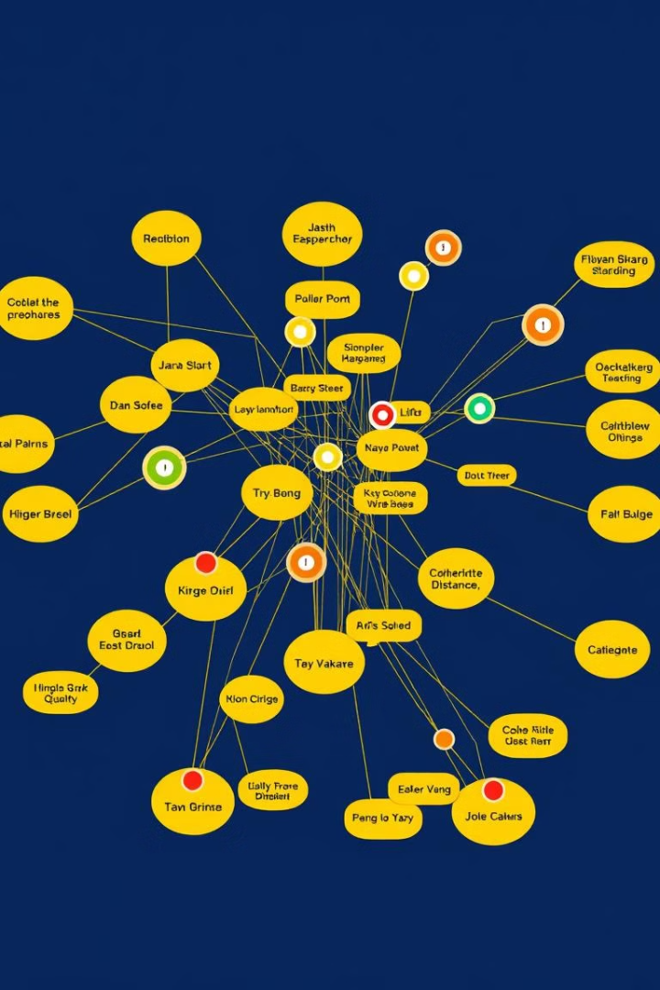
Minimum Spanning Tree (MST) Approach
The MST approach leverages the concept of a spanning tree to construct an approximate TSP tour.
1
Step 1: Construct MST
Find the minimum spanning tree for the given set of cities.
2
Step 2: Traverse MST
Traverse the MST to create a tour that visits all cities.
3
Step 3: Calculate Tour Length
Estimate the total tour length based on the MST edges.

Slide 7
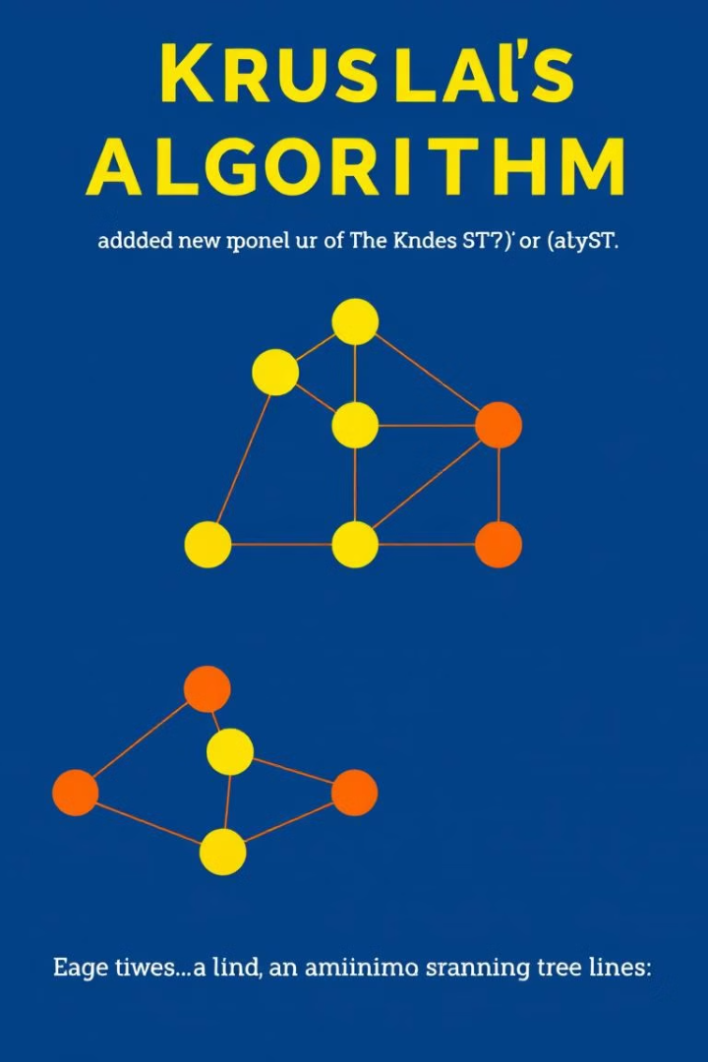


Constructing the MST
Various algorithms can be used to construct the MST, such as Kruskal's Algorithm or Prim's Algorithm.
Kruskal's Algorithm
Prim's Algorithm
Selects edges in ascending order of weight, ensuring no cycles are formed.
Starts with a single vertex and expands the MST by selecting the minimum-weight edge to a non-MST vertex.

Slide 8




Traversing the MST
A depth-first traversal strategy is commonly used to visit each city in the MST once.
Start
Begin at an arbitrary city in the MST.
Visit Unvisited Neighbors
Move to an unvisited neighbor city connected by an edge.
Backtrack
If all neighbors have been visited, backtrack to the previous city.

Slide 9
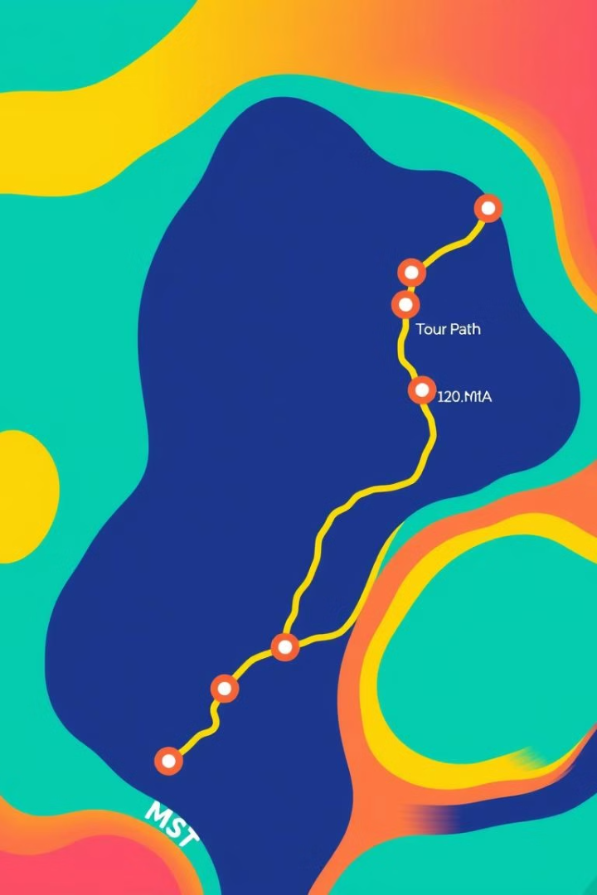
Calculating the Approximate Tour Length
The total distance of the MST provides an approximation of the optimal TSP tour length. Calculating the Approximate Tour Length
This approximation is typically within a factor of 2 of the optimal tour length.

Slide 10

Comparison with Exact TSP Solutions
While MST approximation offers a good balance between efficiency and accuracy, it's not guaranteed to produce the shortest possible tour.
Comparisons with exact TSP solutions, where feasible, can provide insights into the quality of the approximation.

Slide 11

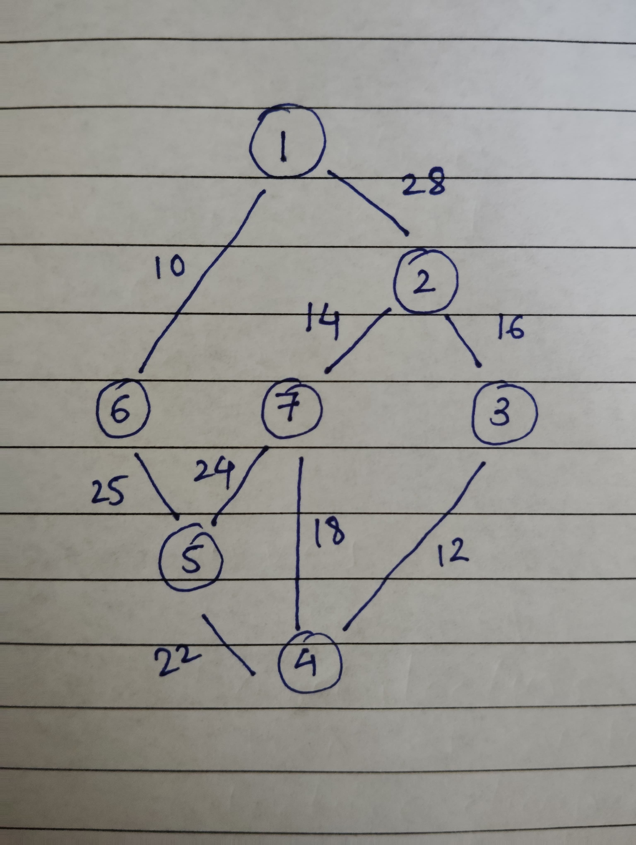

Examples of TSP
1.Prims/Kruskals Algorithm
Time Complexity : O($n^{2}$)
Space Complexity : O(ElogV)

Slide 12

Practical Applications and Real-World Examples
Application
Example
Delivery Services
UPS Package Routing
Tourism
European InterRail Planning
Emergency services
Ambulance service
Educational Field Trips
School Field Trip Planning

Slide 13

Conclusion and Future Directions
The MST approach is a valuable technique for finding approximate solutions to the TSP, particularly for large instances where exact solutions are computationally infeasible.
Future research focuses on developing more accurate and efficient approximation algorithms and exploring advanced techniques for solving complex variations of the TSP.

Slide 14
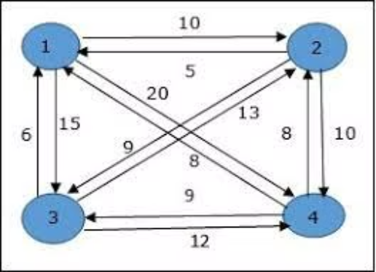
2.Dynamic programming
Time Complexity :
Space Complexity :

